Slide 1
Semantic Image Representation for Visual Recognition
Thesis Defense
Nikhil Rasiwasia, Nuno Vasconcelos
Statistical Visual Computing Laboratory
University of California, San Diego

Slide 2
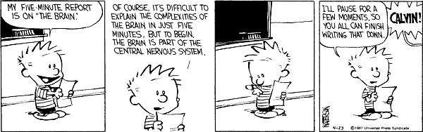
Ill pause for a few moments so that you all can finish reading this.
© Bill Watterson

Slide 3
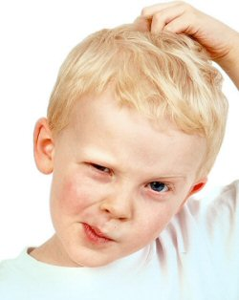
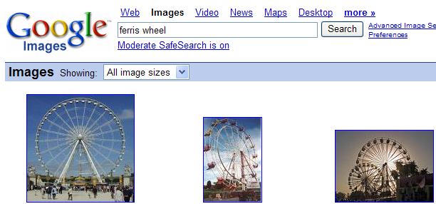
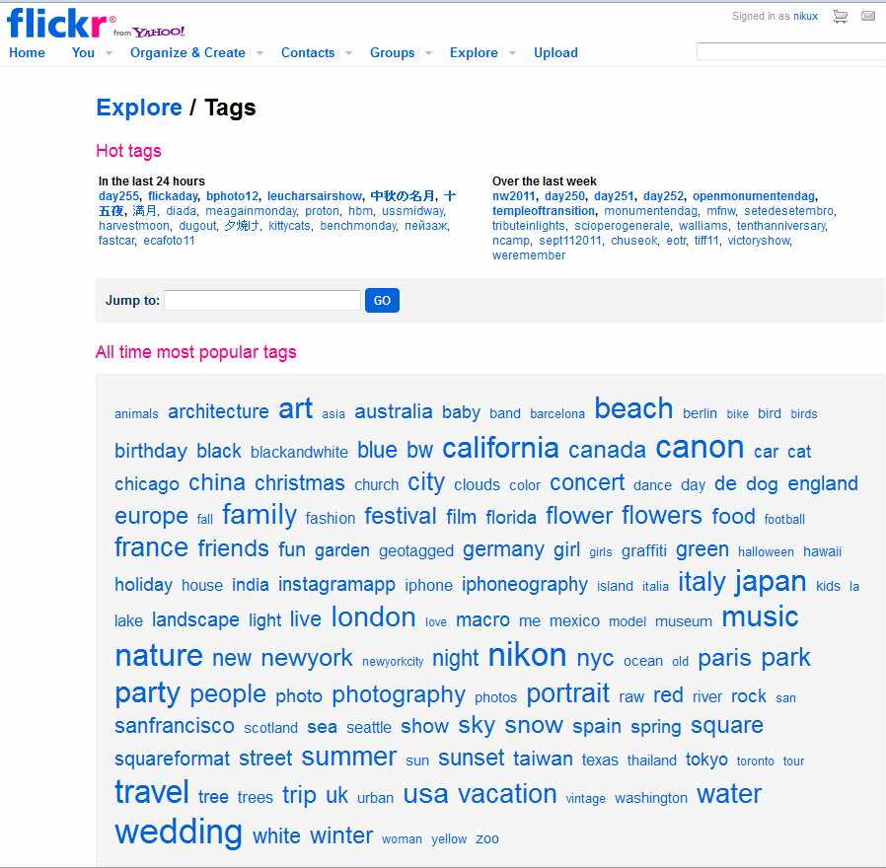
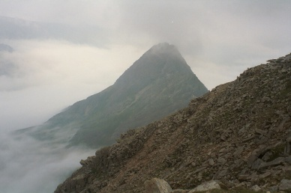
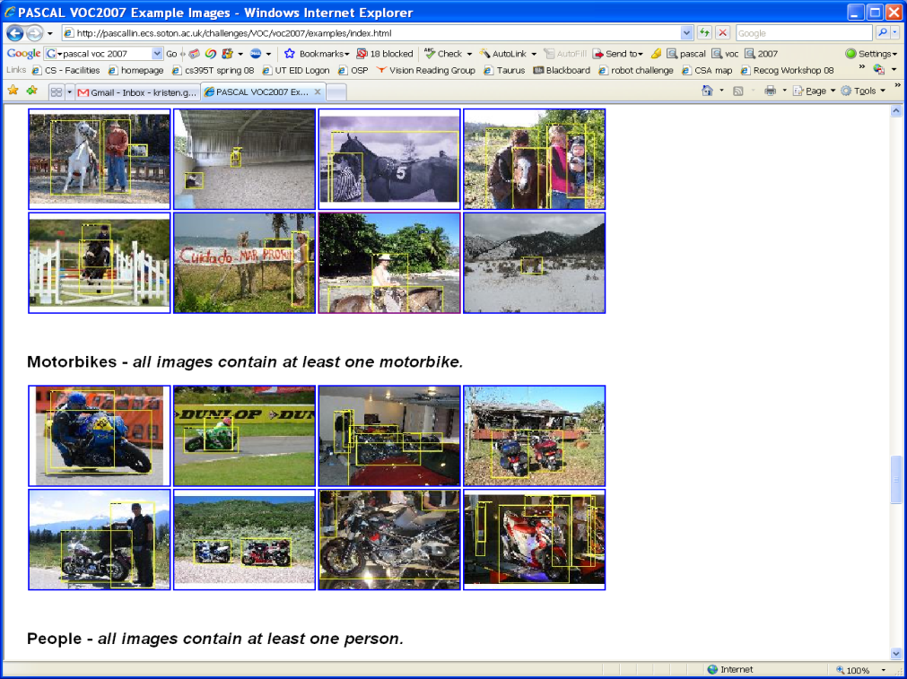
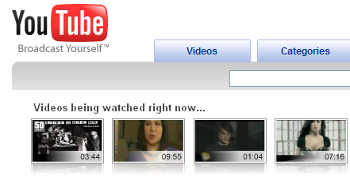
Visual Recognition
Recognition
Humans brains can perform recognition
with astonishing speed and accuracy [Thorpe’96]
Can we make computers perform the
recognition task?
  With astonishing speed and accuracy? :)
Several applications
Visual Signals
Mountain? Beach? Street? Kitchen? Desert?
…
Retrieval
Annotation
Classification
Detection/ Localization
etc.

Slide 4
Why?
Internet in Numbers
  5,000,000,000 – Photos hosted by Flickr (Sept’ 2010).
  3000+ – Photos uploaded per minute to Flickr.
  3,000,000,000 – Photos uploaded per month to Facebook.
  20,000,000 – Videos uploaded to Facebook per month.
  2,000,000,000 – Videos watched per day on YouTube.
  35 – Hours of video uploaded to YouTube every minute.
  Source: http://www.cbsnews.com/8301-501465_162-20028418-501465.html
Several other sources of visual content
  Printed media, surveillance, medical imaging, movies, robots, other automated machines, etc.
…manual processing of the visual content is prohibitive.

Slide 5
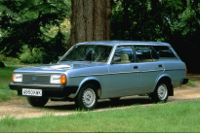

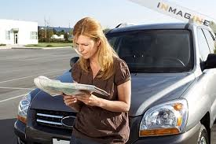
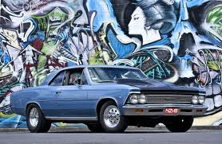

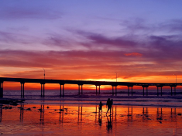



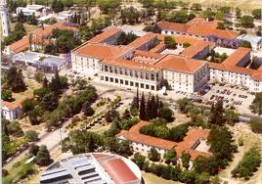
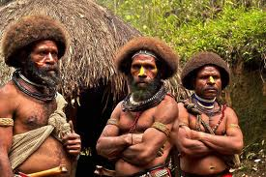
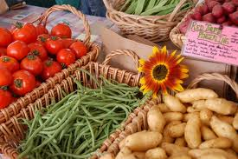
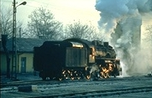

Challenges?
Multiple viewpoints
occlusions, clutter etc.
Multiple illumination,
Semantic gap,
Multiple interpretation,
Role of context, …etc.
Train? Smoke? Railroad? Locomotive? Engine? Sky? Electric Pole? Trees? House? Dark? Track? White?

Slide 6
Outline.
Semantic Image Representation
  Appearance Based Image Representation
  Semantic Multinomial [Contribution]
Benefits for Visual Recognition
  Abstraction: Bridging the Semantic Gap (QBSE) [Contribution]
  Sensory Integration: Cross-modal Retrieval [Contribution]
  Context: Holistic Context Models [Contribution]
Connections to the literature
  Topic Models: Latent Dirichlet Allocation
  Text vs Images
  Importance of Supervision: Topic-supervised Latent Dirichlet Allocation (ts LDA) [Contribution]

Slide 7
Current Approach
Identify classes of interest
Design set of “appearance” based features
  Pixel intensity, color, edges, texture, frequency spectrum, etc.
Postulate an architecture for their recognition
  Generative models, discriminative models, etc.
Learn optimal recognizers from training data
  Expectation Maximization, convex optimization, variational learning, Markov chain Monte Carlo etc.
Reasonably successful in addressing multiple viewpoints / clutter / occlusions, and illumination to an extent.
But: semantic gap? multiple interpretation? role of context?

Slide 8
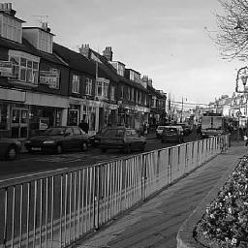


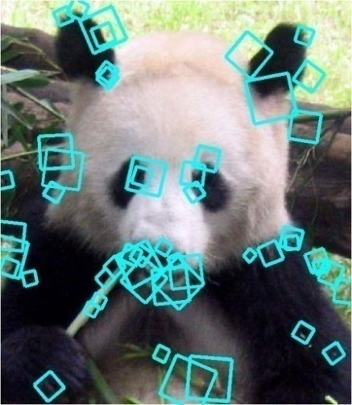

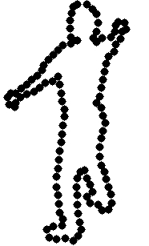
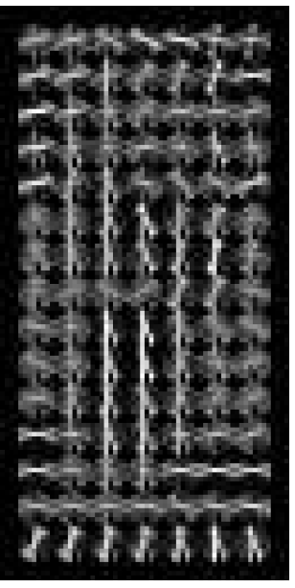
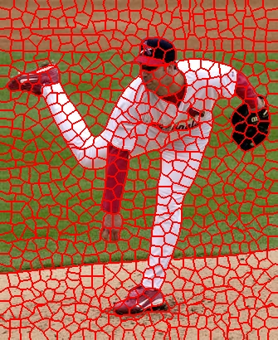
Image Representation
Bag-of-features
  Localized patch based descriptors
  Spatial relations between features are discarded
Image
  Where are N feature vectors
  Defined on the space of low-level appearance features
  Several feature spaces , have been proposed in the literature
Discrete Cosine Transform [Ahmed’74]
…
SIFT [Lowe 99]
Shape context [Belongie 02]
HOG [Dalal 05]
Superpixels [Ren et al.]
etc.

Slide 9
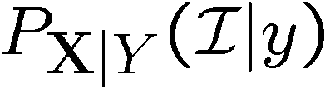
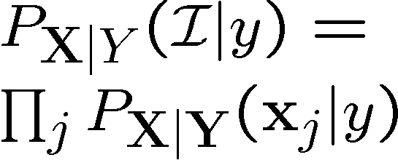
Bag-of-features: Mixtures Approach
Assume each image is a class determined by Y and induces a probability on
Gaussian Mixture Model
+
+
+
+
+
+
+
+
+
+
+
+
+
+
+
+
+
+
+
+
+
+
+
+
+
+
+
+
+
+
+
+
+
+
+
+
+
+
+
+
+
+
+
+
+
+
+
+
+
+
+
+
+
+
+
+
+
+
+
+
+
+
+
+
+
+
+
+
+
+
+
+
+
+
+
+
+
+
+
+
+
+
+
+
+
+
+
+
+
+
+
+
+
+
+
+
+
+
+
+
+
+
+
+
+
+
+
+
+
+
+
+
+
+
+
+
+
+
+
+
+
+
+
+
+
+
+
+
+
+
+
+
+
+
+
+
+
+
+
+
+
+
+
+
+
+
+
+
+
+
+
+
+
+
+
+
+
+
+
+
+
+
+
+
+
+
+
+
+
+
+
+
+
+
+
+
+
+
+
+
+
+
+
+
+
+
+
+
+
+
+
+
+
+
+
+
+
+
+
+
+
+
+
+
+
+
+
+
+
+
+
Expectation Maximization
+
+
+
+
+
+
+
+
+
+
+
+
+
+
+
+
+
Feature Transformation
+
+
+
+
+
+
+
+
+
+
+
+
+
+
+
+
+
+
+
+
+
+
+
+
+
+
+
+
+
+
+
+
+
+
+
+
+
+
+
+
+
+
+
+
+
+
+
+
+
+
+
+
+
+
+
+
+
+
+
+
+
+
+
+
+
+
+
+
+
+
+
+
+
+
+
+
+
+
+
+
+
+
+
+
+
+
+
+
+
+
+
+
+
+
+
+
+
+
+
+
+
+
+
+
+
+
+
+
+
+
+
+
+
+
+
+
+
+
+
+
+
+
+
+
+
+
+
+
+
+
+
+
+
+
+
+
+
+
+
+
+
+
+
+
+
+
+
+
+
+
+
+
+
+
+
+
+
+
+
+
+
+
+
+
+
+
+
+
+
+
+
+
+
+
+
+
+
+
+
+
+
+
+
+
+
+
+
+
+
+
+
+
+
+
+
+
+
+
+
Bag of Features
Appearance Feature Space

Slide 10




Bag-of-words
+
Quantize feature space into unique bins
  Usually K-means clustering
  Each bin, represented by its centroid
  is called a visual-word
  A collection of visual-words forms a codebook,
Each feature vector is mapped to its closest visual word
An image is represented as a collection of visual words,
Also as a frequency count over the visual word codebook
+
+

Slide 11
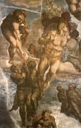
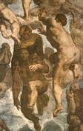
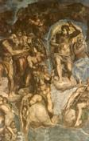
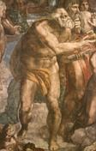
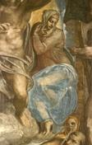
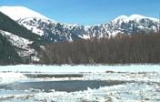
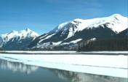
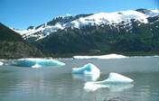
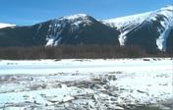
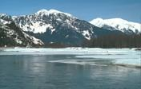

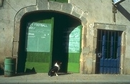
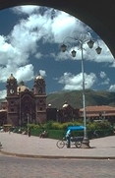
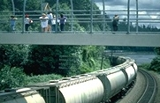
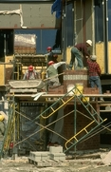

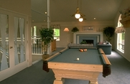
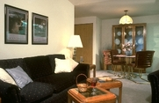

Eg. Image Retrieval
QUERY
TOP MATCHES

Slide 12
Pause for a moment – The Human Perspective
What is this ----------->
  An image of
    Buildings
    Street
    Cars
    Sky
    Flowers
    City scene
    …
Some concepts are more prominent than others.
From ‘Street’ class!

Slide 13
An Image – An Intuition.
Human understanding of images suggests that they are “visual representations” of certain “meaningful” semantic concepts.
There can be several concepts represented by an image.
But, practically impossible to enlist all possible concepts represented
So, define a ‘vocabulary’ of concepts.
Assign weights to the concepts based on their prominence in the image.
{buildings, street, sky, clouds, tree, cars, people, window, footpath, flowers, poles, wires, tires, …}
Vocabulary
Bedroom
Suburb
Kitchen
Living room
Coast
Forest
Highway
Inside city
Mountain
Open country
Street
Tall building
Office
Store
Industrial
bedroom
suburb
kitchen
livingroom
coast
forest
highway
insidecity
mountain
opencountry
street
tall building
office
store
industrial

Slide 14
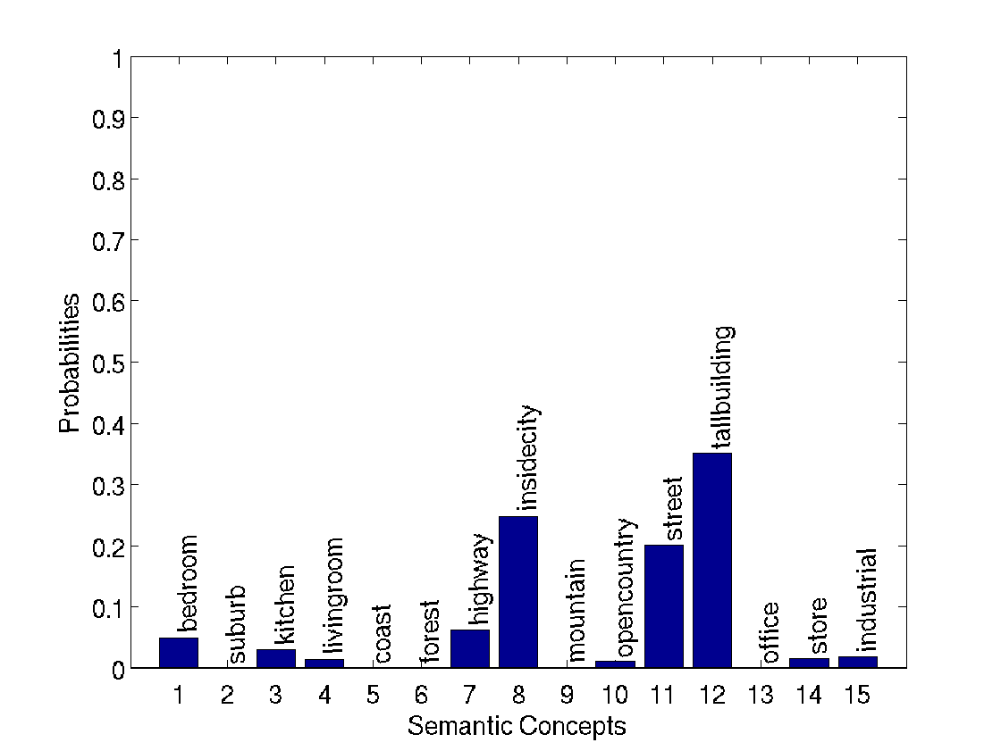
An Image – An Intuition
Semantic gap?
  This has buildings and not forest.
Multiple semantic interpretation?
  Buildings, Inside city
Context?
  Inside city, Street, Highway,
  Buildings co-occur
Notes:
I can have the retrieval example here to make it more clear.

Slide 15

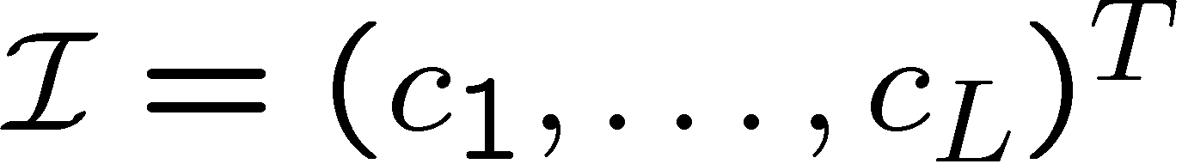



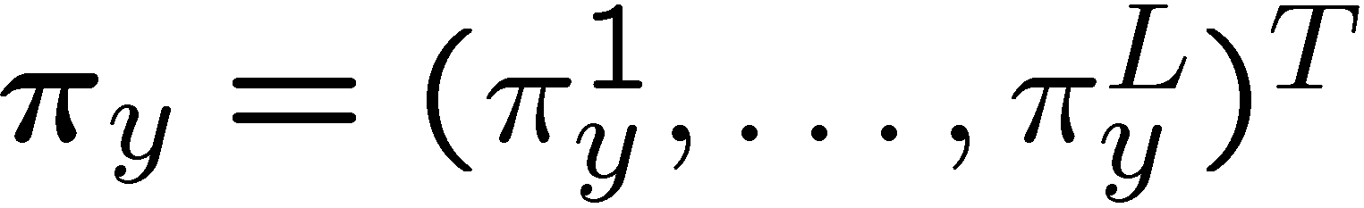
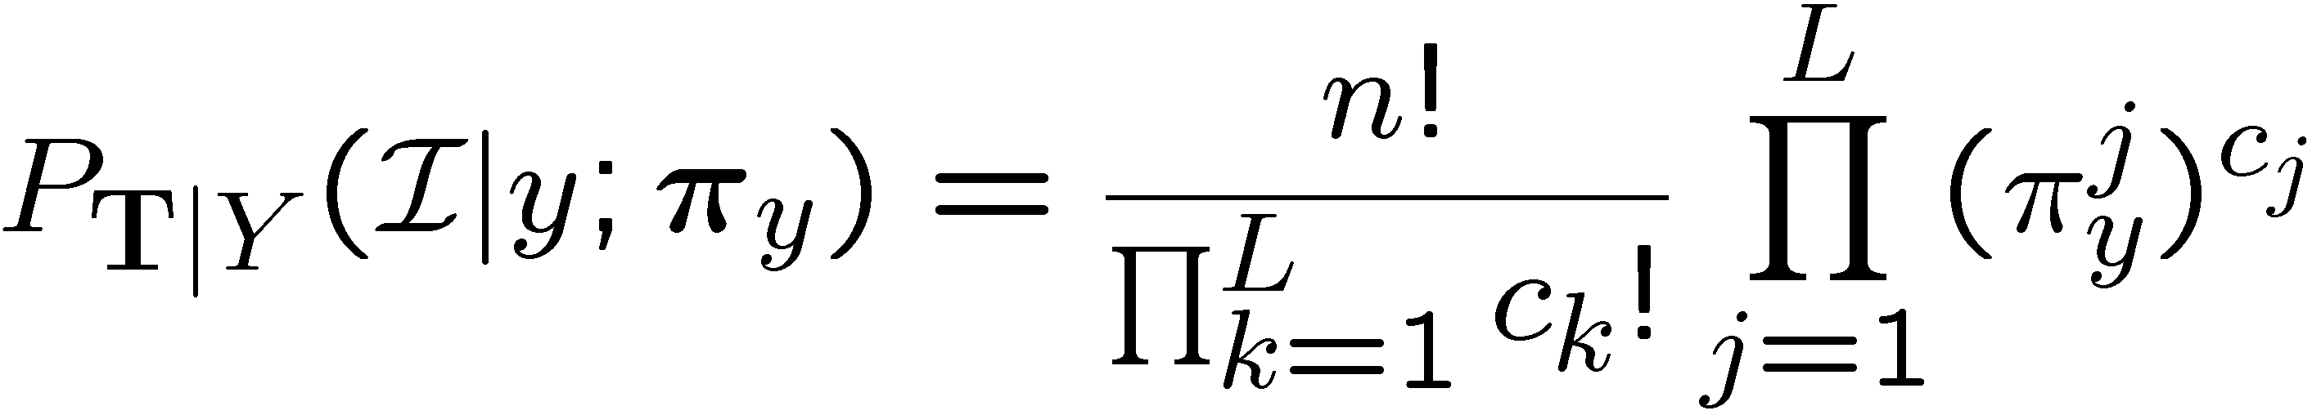

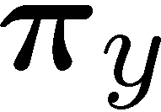
Semantic Image Representation
Builds upon bag-of-features representation
Given a vocabulary of concepts
Image are represented as vectors of concept counts
Where is the number of low level features drawn from the i^{th} concept.
The count vector for y^{th} image is drawn from a multinomial with parameters,
The probability vector is denoted as the Semantic Multinomial (SMN)
can be seen as a feature transformation from to the L-dimensional probability simplex , denoted as the Semantic Space
Semantic Multinomial
Concept 1
x
Concept L
Concept 2

Slide 16
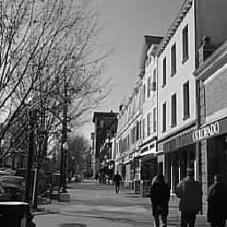
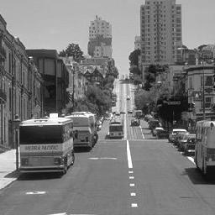
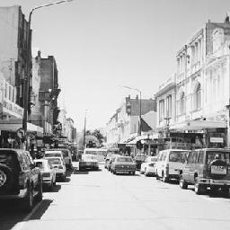
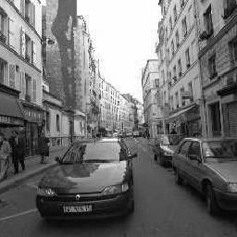
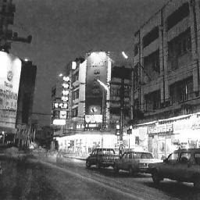
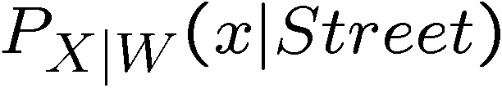
Semantic Labeling System
+
+
+
+
+
+
+
+
+
+
+
+
+
+
+
+
+
+
+
+
+
+
+
+
+
+
+
+
+
+
+
+
+
+
+
+
+
+
+
+
+
+
GMM
+
+
+
+
+
+
+
+
+
+
+
+
+
+
+
+
+
+
+
+
+
+
+
+
+
+
+
+
+
+
+
+
+
+
+
+
+
+
+
+
+
+
+
+
+
+
+
+
+
+
+
+
+
+
+
+
+
+
+
+
+
+
+
+
+
+
+
+
+
+
+
+
+
+
+
+
+
+
+
+
+
+
+
+
+
+
+
+
+
+
+
+
+
+
+
+
+
+
+
+
+
+
+
+
+
+
+
+
+
+
+
+
+
+
+
+
+
+
+
+
+
+
+
+
+
+
+
+
+
+
+
+
+
+
+
+
+
+
+
+
+
+
+
+
+
+
+
+
+
+
+
+
+
+
+
+
+
+
+
+
+
+
+
+
+
+
+
+
+
+
+
+
+
+
+
+
+
+
+
+
+
+
+
+
+
+
+
+
+
+
+
+
+
+
+
+
+
+
+
+
+
+
+
+
+
+
+
+
+
+
+
+
+
+
+
+
+
+
+
+
+
+
+
+
+
+
+
+
+
+
+
+
+
+
+
+
+
+
+
+
+
+
+
+
+
+
+
+
+
+
+
+
+
+
+
+
+
+
+
+
+
+
+
+
+
+
+
+
+
+
+
+
+
+
+
+
+
+
+
+
+
+
+
+
+
+
+
+
+
+
+
+
+
+
+
+
+
+
+
+
+
+
+
+
+
+
+
+
+
+
+
+
+
+
+
+
+
+
+
+
+
+
+
+
+
+
+
+
+
+
+
+
+
+
+
+
+
+
+
+
+
+
+
+
+
+
+
+
+
+
+
+
+
+
+
+
+
+
+
+
+
+
+
+
+
+
+
+
+
+
+
+
+
+
+
+
+
+
+
+
+
+
+
+
+
w_{i} = street
street
Efficient Hierarchical Estimation
Appearance based Class Model
“Formulating Semantics Image Annotation as a Supervised Learning Problem” [G. Carneiro,
IEEE Trans. PAMI, 2007]

Slide 17
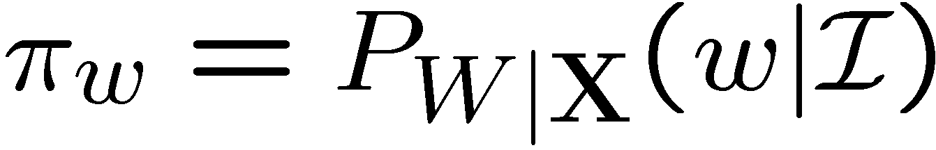






Semantic Labeling System
Appearance based concept models.
Posterior Probabilities
Image
Concepts
Likelihoods
Bedroom
Forest
Inside city
Street
Tall building
…
.
.
.
.
Likelihood under various models

Slide 18
Semantic Image Representation
Semantic Multinomial
Concept 1
x
Concept L
Concept …
Semantic Space
Semantic Labeling System

Slide 19

Semantic Multinomial
Notes:
Use this also motivate consistency argument.

Slide 20



Slide 21



Slide 22
Was alone, not anymore!
Learning visual attributes by Ferrari,V.,Zisserman,A (NIPS 2007)
Describing objects by their attributes by Farhadi, A., Endres, I., Hoiem, D., Forsyth, D. (CVPR 2009)
Learning to detect unseen object classes by between-class attribute transfer by Lampert, C.H., Nickisch, H., Harmeling, S. (CVPR 2009)
Joint learning of visual attributes, object classes and visual saliency by Wang, G., Forsyth, D.A. (ICCV2009)
Attribute-centric recognition for cross-category generalization by Farhadi, A., Endres, I., Hoiem, D. (CVPR 2010)
A Discriminative Latent Model of Object Classes and Attributes by Yang Wang, Greg Mori (ECCV 2010)
Recognizing Human Actions by Attributes by Jingen Liu, Benjamin Kuipers, Silvio Savarese (CVPR 2011)
Interactively Building a Discriminative Vocabulary of Nameable Attributes by Devi Parikh, Kristen Grauman (CVPR 2011)
Sharing Features Between Objects and Their Attributes by Sung Ju Hwang, Fei Sha, Kristen Grauman (CVPR 2011)

Slide 23
Outline.
Semantic Image Representation
  Appearance Based Image Representation
  Semantic Multinomial [Contribution]
Benefits for Visual Recognition
  Abstraction: Bridging the Semantic Gap (QBSE) [Contribution]
  Sensory Integration: Cross-modal Retrieval [Contribution]
  Context: Holistic Context Models [Contribution]
Connections to the literature
  Topic Models: Latent Dirichlet Allocation
  Text vs Images
  Importance of Supervision: Topic-supervised Latent Dirichlet Allocation (ts LDA) [Contribution]

Slide 24




Higher abstraction
“train +
railroad”
“whitish +
darkish”
QBSE
QBVE

Slide 25







Out of Vocabulary Generalization
VS
Commercial Construction
People 0.09
Buildings 0.07
Street 0.07
Statue 0.05
Tables 0.04
Water 0.04
Restaurant 0.04
QBVE
People 0.08
Statue 0.07
Buildings 0.06
Tables 0.05
Street 0.05
Restaurant 0.04
House 0.03
QBSE
Buildings 0.06
People 0.06
Street 0.06
Statue 0.04
Tree 0.04
Boats 0.04
Water 0.03
People 0.12
Restaurant 0.07
Sky 0.06
Tables 0.06
Street 0.05
Buildings 0.05
Statue 0.05
People 0.1
Statue 0.08
Buildings 0.07
Tables 0.06
Street 0.06
Door 0.05
Restaurant 0.04

Slide 26












Robust Estimation of SMN
Regularization of the semantic multinomials
  Using conjugate prior: Dirichlet distribution with parameter
Semantic labeling systems should have “soft” decisions
Notes:
This is what computer vision is all about right now. Come back to it later on.

Slide 27





The Semantic Gain
Is the gain really due to the semantic structure of the semantic space?
Tested by building semantic spaces with no semantic structure
  Random image groupings
With random groupings
  quite poor, indeed worse than QBVE
  there seems to be an intrinsic gain of relying on a space where the features are semantic
w_{i} = random imgs

Slide 28
Outline.
Semantic Image Representation
  Appearance Based Image Representation
  Semantic Multinomial [Contribution]
Benefits for Visual Recognition
  Abstraction: Bridging the Semantic Gap (QBSE) [Contribution]
  Sensory Integration: Cross-modal Retrieval [Contribution]
  Context: Holistic Context Models [Contribution]
Connections to the literature
  Topic Models: Latent Dirichlet Allocation
  Text vs Images
  Importance of Supervision: Topic-supervised Latent Dirichlet Allocation (ts LDA) [Contribution]

Slide 29



Sensory Integration
Recognition systems that are transparent to different information modalities
  Text, Images, Music, Video, etc.
Cross-modal Retrieval: systems that operates across multiple modalities
  Cross modal text query, eg. retrieval of images from photoblogs using text
  Finding images to go along with a text article
  Finding music to enhance videos, slide shows.
  Image positioning.
  Text summarization based on images
  and much more…

Slide 30












Cross-modal Retrieval
Current retrieval systems are
predominantly uni-modal.
  The query and retrieved results are
  from the same modality
Cross-modal Retrieval: Given query from modality A, retrieve results from modality B.
  The query and retrieved items are not required to share a common modality.
Text
Text
Images
Images
Music
Music
Videos
Videos
Like most of the UK, the Manchester area mobilised extensively during World War II. For example, casting and machining expertise at Beyer, Peacock and Company's locomotive works in Gorton was switched to bomb making; Dunlop's rubber works in Chorlton-on-Medlock made barrage balloons;
Text
.
.
.
Text
Martin Luther King's presence in Birmingham was not welcomed by all in the black community. A black attorney was quoted in ''Time'' magazine as saying, "The new administration should have been given a chance to confer with the various groups interested in change. …
Images
Images
⬄
In 1920, at the age of 20, Coward starred in his own play, the light comedy ''I'll Leave It to You''. After a tryout in Manchester, it opened in London at the New Theatre (renamed the Noël Coward Theatre in 2006), his first full-length play in the West End.Thaxter, John. British Theatre Guide, 2009 Neville Cardus's praise in ''The Manchester Guardian''
Like most of the UK, the Manchester area mobilised extensively during World War II. For example, casting and machining expertise at Beyer, Peacock and Company's locomotive works in Gorton was switched to bomb making; Dunlop's rubber works in Chorlton-on-Medlock made barrage balloons;
Music
Music
In 1920, at the age of 20, Coward starred in his own play, the light comedy ''I'll Leave It to You''. After a tryout in Manchester, it opened in London at the New Theatre (renamed the Noël Coward Theatre in 2006), his first full-length play in the West End.Thaxter, John. British Theatre Guide, 2009 Neville Cardus's praise in ''The Manchester Guardian''
Videos
Videos
Martin Luther King's presence in Birmingham was not welcomed by all in the black community. A black attorney was quoted in ''Time'' magazine as saying, "The new administration should have been given a chance to confer with the various groups interested in change. …

Slide 31


The problem.
No natural correspondence between representations of different modalities.
For example, we use Bag-of-words representation for both images and text
  Images: vectors over visual textures ( )
  Text: vectors of word counts ( )
How do we compute similarity? An intermediate space.
Image Space
Text Space
Like most of the UK, the Manchester area mobilised extensively during World War II. For example, casting and machining expertise at Beyer, Peacock and Company's locomotive works in Gorton was switched to bomb making; Dunlop's rubber works in Chorlton-on-Medlock made barrage balloons;
?
?
In 1920, at the age of 20, Coward starred in his own play, the light comedy ''I'll Leave It to You''. After a tryout in Manchester, it opened in London at the
Martin Luther King's presence in Birmingham was not welcomed by all in the black community. A black attorney was quoted in ''Time'' magazine as saying, "The new administration should have been given a chance to confer with the various groups interested in change. …
The population of Turkey stood at 71.5 million with a growth rate of 1.31% per annum, based on the 2008 Census. It has an average population density of 92 persons per km². The proportion of the population residing in urban areas is 70.5%. People within the 15–64 age group constitute 66.5% of the total population, the 0–14 age group corresponds 26.4% of th
In 1920, at the age of 20, Coward starred in his own play, the light comedy ''I'll Leave It to You''. After a tryout in Manchester, it opened in London at the New Theatre (renamed the Noël Coward Theatre in 2006), his first full-length play in the West End.Thaxter, John. British Theatre Guide, 2009 Neville Cardus's praise in ''The Manchester Guardian''
SkyBomb
Terrorist
India
Success
Weather
Prime
President
Navy
Army
Sun
Books
Music
Food
Poverty
Iran
America

Slide 32

Semantic Matching (SM)
Semantic representation provides a modality independent representation
  Is a natural choice for an intermediate space
Design semantic spaces for both modalities
  Recall, a space where each dimension is a semantic concept.
  And each point on this space is a weight vector over these concepts
Semantic Concept 1
Semantic Space
Image Space
R ^{I}
S
Art
Biology
Places
History
Literature
…
…
…
…
Warfare
Semantic Concept V
Text Space
Martin Luther King's presence in Birmingham was not welcomed by all in the black community. A black attorney was quoted in ''Time'' magazine as saying, "The new administration
R ^{T}
Semantic Concept 2

Slide 33



Cross Modal Retrieval
Ranking is based on a suitable similarity function
Text to images retrieval using SM
Images to text retrieval using SM
Closest Text to the Query Image
Closest Text to the Query Image
Concept 1
Like most of the UK, the Manchester area mobilised extensively during World War II. For example, casting and machining expertise at Beyer, Peacock and Company's locomotive works in Gorton was switched to bomb making; Dunlop's rubber works in Chorlton-on-Medlock made barrage balloons;
Concept 1
Like most of the UK, the Manchester area mobilised extensively during World War II. For example, casting and machining expertise at Beyer, Peacock and Company's locomotive works in Gorton was switched to bomb making; Dunlop's rubber works in Chorlton-on-Medlock made barrage balloons;
Like most of the UK, the Manchester area mobilised extensively during World War II. For example, casting and machining expertise at Beyer, Peacock and Company's locomotive works in Gorton was switched to bomb making; Dunlop's rubber works in Chorlton-on-Medlock made barrage balloons;
Like most of the UK, the Manchester area mobilised extensively during World War II. For example, casting and machining expertise at Beyer, Peacock and Company's locomotive works in Gorton was switched to bomb making; Dunlop's rubber works in Chorlton-on-Medlock made barrage balloons;
Like most of the UK, the Manchester area mobilised extensively during World War II. For example, casting and machining expertise at Beyer, Peacock and Company's locomotive works in Gorton was switched to bomb making; Dunlop's rubber works in Chorlton-on-Medlock made barrage balloons;
Like most of the UK, the Manchester area mobilised extensively during World War II. For example, casting and machining expertise at Beyer, Peacock and Company's locomotive works in Gorton was switched to bomb making; Dunlop's rubber works in Chorlton-on-Medlock made barrage balloons;
Concept L
Concept L
Concept 2
Concept 2
Semantic Space
Semantic Space

Slide 34
Semantic Matching (SM)
  We use bag-of-words for both image and text representation
  Different possible classifiers: SVM, Logistic Regression, Bayes Classifier.
We use multiclass logistic regression to classify both text and images
The posterior probability under the learned classifiers serves as the semantic representation
Text/Image features
Learned parameters
Total number of classes

Slide 35


Evaluation
Dataset?
  Wikipedia Featured Articles [Novel]
  TVGraz [Khan et al’09]
  Both datasets have 10 classes and about 3000 image-text pairs.
Around 850, out of obscurity rose Vijayalaya, made use of an opportunity arising out of a conflict between Pandyas and Pallavas, captured Thanjavur and eventually established the imperial line of the medieval Cholas. Vijayalaya revived the Chola dynasty and his son Aditya I helped establish their independence. He invaded Pallava kingdom in 903 and killed the Pallava king Aparajita in battle, ending the Pallava reign. K.A.N. Sastri, ''A History of South India‘’…
Source: http://en.wikipedia.org/wiki/History_of_Tamil_Nadu#Cholas
On the Nature Trail behind the Bathabara Church ,there are numerous wild flowers and plants blooming, that attract a variety of insects,bees and birds. Here a beautiful Butterfly is attracted to the blooms of the Joe Pye Weed.
Source: www2.journalnow.com/ugc/snap/community-events/beautiful-butterfly/1528/

Slide 36

Text to Image Query
Around 850, out of obscurity rose Vijayalaya, made use of an opportunity arising out of a conflict between Pandyas and Pallavas, captured Thanjavur and eventually established the imperial line of the medieval Cholas. Vijayalaya revived the Chola dynasty and his son Aditya I helped establish their independence. He invaded Pallava kingdom in 903 and killed the Pallava king Aparajita in battle, ending the Pallava reign. K.A.N. Sastri, ''A History of South India'' p 159 The Chola kingdom under Parantaka I expanded to cover the entire Pandya country. However towards the end of his reign he suffered several reverses by the Rashtrakutas who had extended their territories well into the Chola kingdom…
Top 5 Retrieved Images

Slide 37

Text to Image Query
On the Nature Trail behind the Bathabara Church ,there are numerous wild flowers and plants blooming, that attract a variety of insects,bees and birds. Here a beautiful Butterfly is attracted to the blooms of the Joe Pye Weed.
Top 5 Retrieved Images

Slide 38

Text to Image Retrieval Example
Ground truth image corresponding to the retrieved text is shown

Slide 39
Retrieval Performance
Mean Average Precision
Chance: Random chance performance
Correlation Matching (CM):
  Learn intermediate spaces by maximizing correlation between different modalities.
  A low-level approach
SM performs better than CM
  Across both queries
  Across both datasets
TVGraz
Wikipedia

Slide 40
Outline.
Semantic Image Representation
  Appearance Based Image Representation
  Semantic Multinomial [Contribution]
Benefits for Visual Recognition
  Abstraction: Bridging the Semantic Gap (QBSE) [Contribution]
  Sensory Integration: Cross-modal Retrieval [Contribution]
  Context: Holistic Context Models [Contribution]
Connections to the literature
  Topic Models: Latent Dirichlet Allocation
  Text vs Images
  Importance of Supervision: Topic-supervised Latent Dirichlet Allocation (ts LDA) [Contribution]

Slide 41
Revisit Bag-of-features
Certain inherent issues with bag-of-features model
In isolation the feature might not be informative enough.
The problem of
  Polysemy: one word can have multiple meanings
  Synonymy: multiple words have the same meaning

Slide 42
Contextual Noise
Mountain, Forest, Coast
  No probability
Livingroom, Bedroom, Kitchen
  Ambiguity co-occurrence
  Problem of Polysemy
Inside city, street, buildings.
  Contextual Co-occurrence
  Problem of Synonymy
Contextual co-occurrences are benevolent
  Expected to be found in most images of a given class
Ambiguity co-occurrences are malevolent
  However, they might not be consistent

Slide 43






A Second Semantic Level
Introduce a second level of semantic representation.
Model the concepts on the semantic space
Such that,
  It promotes contextual co-occurrences
  And, demotes ambiguity co-occurrences
Mountains

Slide 44

Contextual Class Modeling
SMN’s lie on a probabilistic space
Model concepts as Mixture of Dirichlet Distributions.
Concept 1
Dirichlet Mixture Model
Generalized
Expectation
Maximization.
x
x
x
x
x
x
Concept L
x
Concept
2
Semantic Space
Contextual concept model
Images from a concept

Slide 45









Generating the contextual representation
Visual
concept models
Contextual
Concept models
Contextual
Multinomial
Training / Query Image
Semantic
Multinomial
Concept 1
. . .
. . .
x
Concept L
Contextual
Space
Bag of features
Concept 2
Learning the Visual Class Models [Carneiro’05]
Learning the Contextual Class Models
Bag of features
Dirichlet Mixture Model
+
+
Gaussian Mixture Model
+
+
+
+
+
+
+
+
+
+
+
+
+
+
+
+
Concept 1
+
+
+
+
+
+
+
+
+
+
+
+
+
+
+
+
+
+
+
+
+
+
+
+
+
+
+
+
+
+
+
+
+
+
+
+
+
+
+
+
+
+
+
+
+
+
+
+
+
+
+
+
+
+
+
+
+
+
+
+
+
+
+
+
+
+
+
+
+
+
+
+
+
+
+
+
+
+
+
+
+
+
+
+
+
+
+
+
+
+
+
+
+
+
+
+
+
+
+
+
+
+
+
+
+
+
+
+
+
+
+
+
+
+
+
+
+
+
+
+
+
+
+
+
+
+
+
+
+
+
+
+
+
+
+
+
+
+
+
+
+
+
+
+
+
+
+
+
+
+
+
+
+
+
+
+
+
+
+
+
+
+
+
+
+
+
+
+
+
+
+
+
+
+
+
+
+
+
+
+
+
+
+
+
+
+
+
+
+
+
+
+
+
+
+
+
+
+
+
+
+
+
+
+
+
+
+
+
+
+
+
+
+
+
+
+
+
+
+
+
+
+
+
+
+
+
+
+
+
+
+
+
+
+
+
+
+
+
+
+
+
+
+
+
+
+
+
+
+
+
+
+
+
+
+
+
+
+
+
+
+
+
+
+
+
+
+
+
+
+
+
+
+
+
+
+
+
+
+
+
+
+
+
+
+
+
+
+
+
+
+
+
+
+
+
+
+
+
+
+
+
+
+
+
+
+
+
+
+
+
+
+
+
+
+
+
+
+
+
+
+
+
+
+
+
+
+
+
+
+
+
+
+
+
+
+
+
+
+
+
+
+
+
+
+
+
+
+
+
+
+
+
+
+
+
+
+
+
+
+
+
+
+
+
+
+
+
+
+
+
+
+
+
+
+
+
+
+
+
+
+
+
+
+
+
+
+
+
+
+
+
+
+
+
+
+
+
+
+
+
+
+
+
+
+
+
+
+
+
Concept L
Efficient Hierarchical Estimation
...
x
x
w_{i} = mountain
Mountain
x
x
x
x
x
Contextual model of the semantic concept.
Concept
2
Semantic Space
Visual Features
Space
concept
training images

Slide 46




Semantic Multinomial
Contextual Multinomial

Slide 47




Experimental Evaluation
Notes:
Show bar for invariance to visual features

Slide 48
Interesting Observation
Classification accuracy for Natural15 dataset
For different choice of
  Appearance features
  Inference algorithm
Contextual models
  Perform better than
  appearance based models
And superior performance is independent of the choice of the feature representation and inference algorithm.

Slide 49
Outline.
Semantic Image Representation
  Appearance Based Image Representation
  Semantic Multinomial [Contribution]
Benefits for Visual Recognition
  Abstraction: Bridging the Semantic Gap (QBSE) [Contribution]
  Sensory Integration: Cross-modal Retrieval [Contribution]
  Context: Holistic Context Models [Contribution]
Connections to the literature
  Topic Models: Latent Dirichlet Allocation
  Text vs Images
  Importance of Supervision: Topic-supervised Latent Dirichlet Allocation (ts LDA) [Contribution]

Slide 50













Topic Models
Bayesian networks
  is a way of representing probabilistic
  relationships between random variables.
  variables are represented by nodes
  directed edges give causality relationships
  Eg. Appearance model of a concept
Holistic context models bear close
resemblance with “topic models”
  e.g. Latent Dirichlet Allocation (LDA),
  probabilistic Latent Semantic Analysis
Latent Dirichlet Allocation [Blei’02]
  Proposed for modeling a corpus of documents
  Documents are represented as mixtures
  over latent topics
  Topic are distributions over words
Appearance Model
IID process
LDA
Plate Notation

Slide 51




Example
money
money
.8
bank
loan
loan
money¹ bank¹ bank¹ loan¹ river² stream² bank¹ money¹ river² bank¹ money¹ bank¹ loan¹ money¹ stream² bank¹ money¹ bank¹ bank¹ loan¹ river² stream² bank¹ money¹ river² bank¹ money¹ bank¹ loan¹ bank¹ money¹ stream²
bank
bank
loan
DOCUMENT 1
TOPIC 1
river
bank
.2
river
stream
Document Distribution over topics
river
bank
stream
TOPIC 2
Topic Conditional Distributions

Slide 52
Text and Image are different
Semantic gap: Equivalence of feature distributions does not translate into semantic equivalence
  Text features are words which have an inherent semantic meaning!
  Image features are visual-words and have no semantic meaning!
this circle with colored segments spans three hundred and sixty degrees
with colored segments this circle spans three hundred and sixty degrees
this circle spans three hundred and sixty degrees with colored segments
with colored segments three hundred and sixty degrees this circle spans
Four different text documents with the same bag of words representation
Four different images with the same bag of words representation
Have similar semantics!
Have completely different semantics!

Slide 53

Supervised Extensions of LDA
Note that LDA does not model classes, thus can not be directly used for supervised visual recognition tasks.
Class LDA (cLDA) [Li. Fei Fei’ 05]
  Class label is parent to the topic
  mixing probability
  Similar to the two-layer holistic
  context model
Supervised LDA (sLDA) [Blei’08]
  Class label introduced later in the
  hierarchy
cLDA
sLDA

Slide 54


Holistic Models and cLDA
Visual
concept models
Contextual
Concept models
Contextual
Multinomial
Training / Query Image
Semantic
Multinomial
Concept 1
. . .
. . .
x
Concept L
Contextual
Space
Bag of features
Concept 2
Class Posterior

Slide 55
Holistic Context Models vs cLDA
There is structural similarity
However, holistic context models performs significantly superior
  Scene classification accuracies
This puzzled us!
  What are the exact differences?
  Which is the one that matters!
Method | N15 | N13 | C50 | C43
Contextual Models | ~77 | ~80 | ~57 | ~42
cLDA | ~60 | ~65 | ~31 | ~25

Slide 56



Unsupervised Discovery of Topic Distributions
Theoretical analysis: Impact of class labels on topics is very weak.
Experimental analysis: Severing connection to class label during learning does not deteriorate the performance.
Notes:
Stick image text vs image: semantic gap
Drop in performace – semantic gain

Slide 57





Unsupervised Topic Discovery
What happens in unsupervised topic discovery?
Sailing
Rowing

Slide 58
Holistic Models and cLDA
Visual
concept models
Contextual
Concept models
Contextual
Multinomial
Training / Query Image
Semantic
Multinomial
Concept 1
. . .
. . .
x
Concept L
Contextual
Space
Bag of features
Concept 2
Class Posterior

Slide 59



Topic-supervised LDA
Solution: Supervision
  In holistic context models, appearance based class models (which correspond to the topics distributions) are learned under supervision.
So can we conclude that supervision is the key?
  Not yet! Holistic context models have different image representations and learning framework.
  So, borrow the ideas from holistic context models and apply to LDA, maintaining the LDA framework.
Topics-supervised LDA models
  the set of topics is the set of class labels
  the samples from the topic variables are class labels.
  the topic conditional distributions are learned in a supervised manner.
  The generative process is the same.

Slide 60



Why does it work?
What happens in topic-supervised models?
Sailing
Rowing

Slide 61




Scene Classification
Supervision in topic models leads to significant improvements

Slide 62
In conclusion
Low-level representation
  Improving low level classifiers is not the complete answer
  Postpone hard decision – Data processing theorem
Semantic representation
  Provides a higher level of abstraction
  Bridges the semantic gap
  Is a universal representation and bridges the ‘modality gap’
  Accounts for contextual relationships between concepts
Text and images are different
  Techniques from text might not directly apply to images.
  LDA and its variants as proposed, are not successful for supervised visual recognition tasks
Importance of supervision
  Supervision is the key in building high performance recognition systems.

Slide 63
Acknowledgements
PhD advisor: Nuno Vasconcelos
Doctoral Committee:
  Prof. Serge J. Belongie,
  Prof. Kenneth Kreutz-Delgado,
  Prof. David Kriegman,
  Prof. Truong Nguyen
Colleagues and Collaborators
  Antoni Chan, Dashan Gao, Hamed Masnadi-Shirazi, Sunhyoung Han, Vijay Mahadevan, Jose Maria Costa Pereira, Mandar Dixit, Mohammad Saberian, Kritika Muralidharan and Weixin Li
  Emanuele Coviello, Gabe Doyle, Gert Lanckriet, Roger Levy, Pedro Moreno.
Friends from San Diego, most of whom are no longer in San Diego.
My parents and my family

Slide 64

Questions?
© Bill Watterson

Slide 65







Slide 66



An Idea
Learn mappings ( ) that maps different modalities into intermediate spaces ( ) that have a natural and invertible correspondence ( )
Given a text query in the cross-modal retrieval reduces to find the nearest neighbor of:
Similarly for image query:
The task now is to design these mappings.
Image Space
Text Space
Like most of the UK, the Manchester area mobilised extensively during World War II. For example, casting and machining expertise at Beyer, Peacock and Company's locomotive works in Gorton was switched to bomb making; Dunlop's rubber works in Chorlton-on-Medlock made barrage balloons;
Martin Luther King's presence in Birmingham was not welcomed by all in the black community. A black attorney was quoted in ''Time'' magazine as saying, "The new administration should have been given a chance to confer with the various groups interested in change. …
In 1920, at the age of 20, Coward starred in his own play, the light comedy ''I'll Leave It to You''. After a tryout in Manchester, it opened in London at the New Theatre (renamed the Noël Coward Theatre in 2006), his first full-length play in the West End.Thaxter, John. British Theatre Guide, 2009 Neville Cardus's praise in ''The Manchester Guardian''

