Slide 1

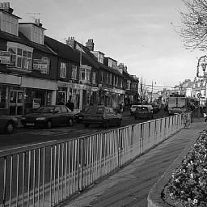
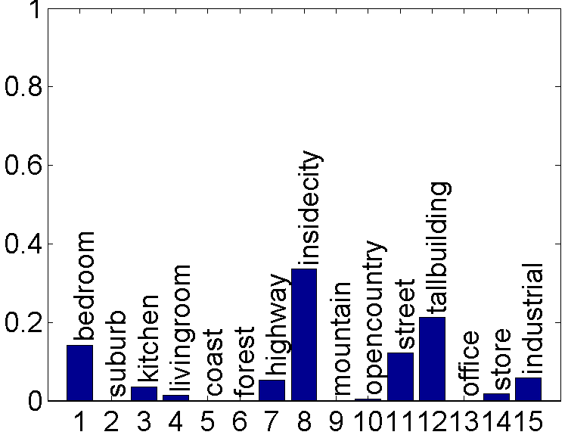
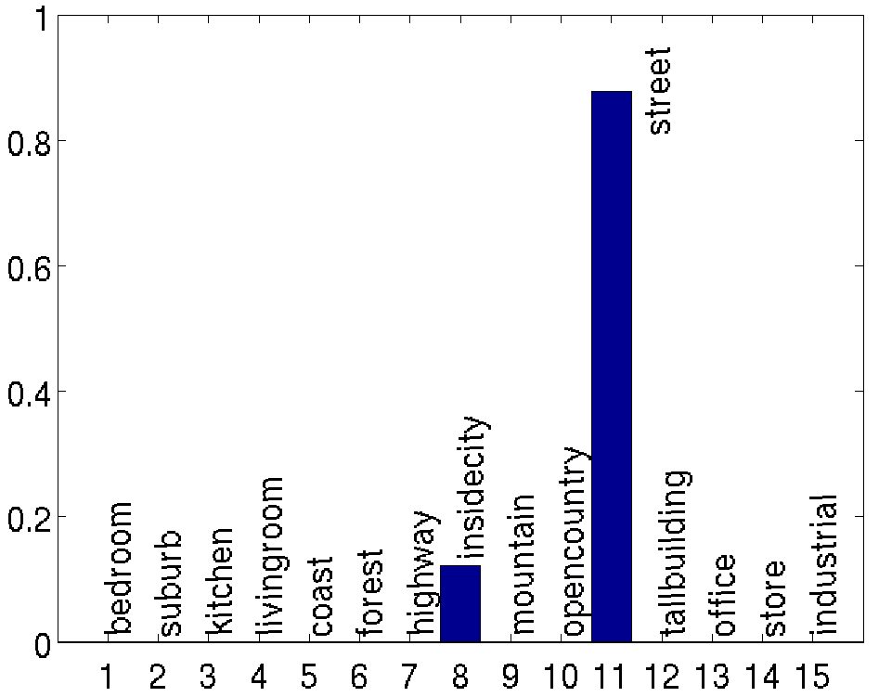
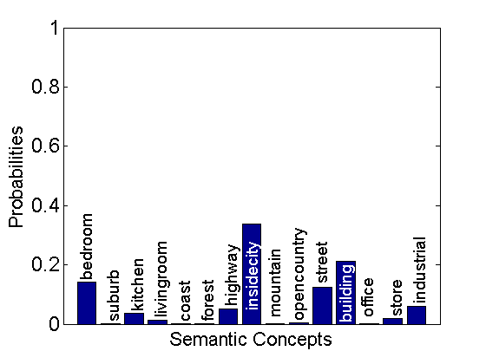
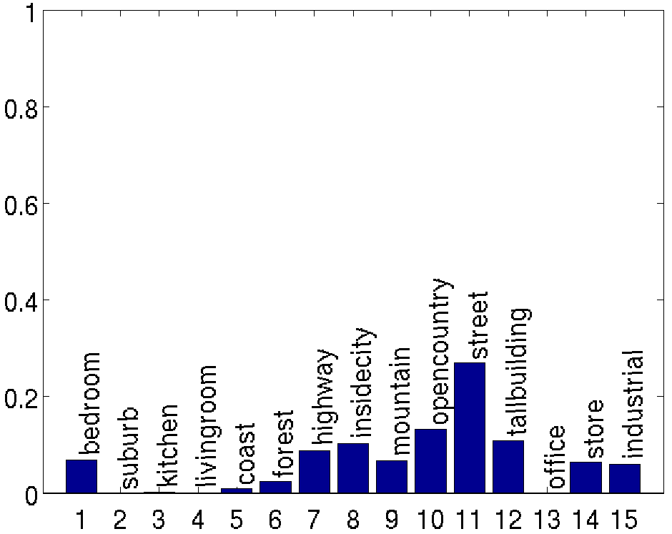
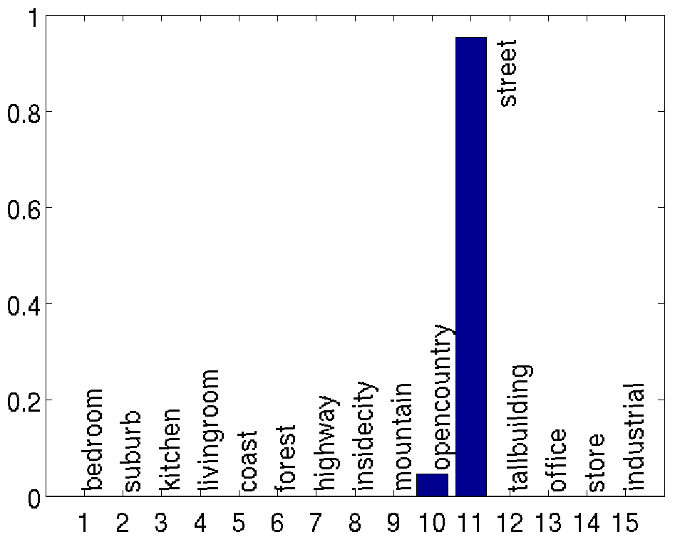
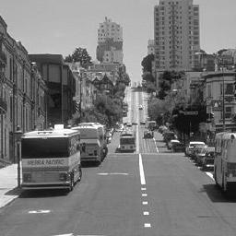

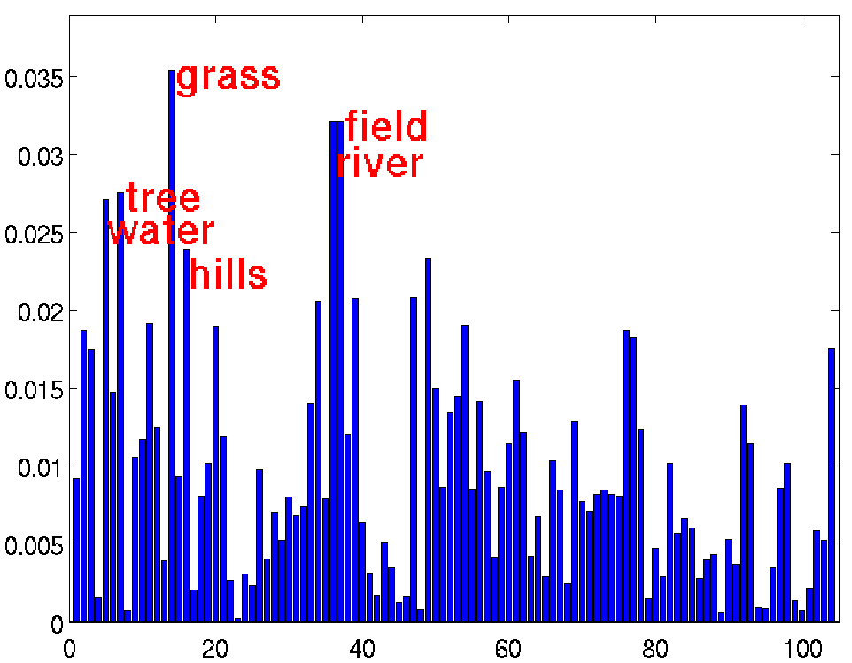
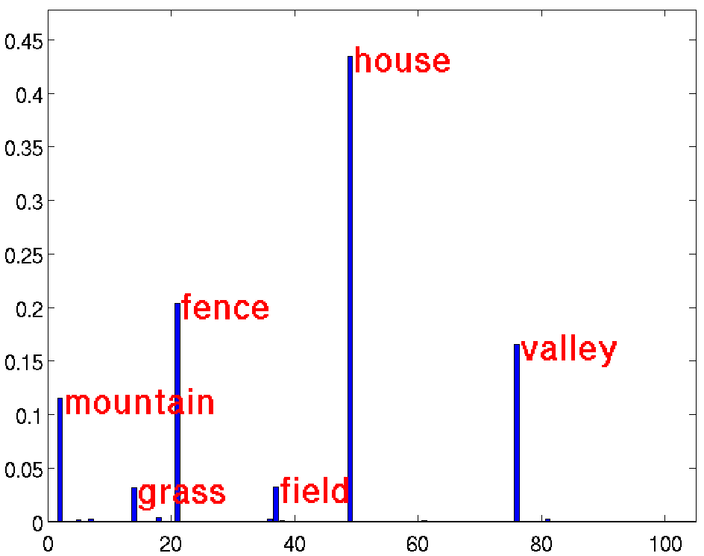


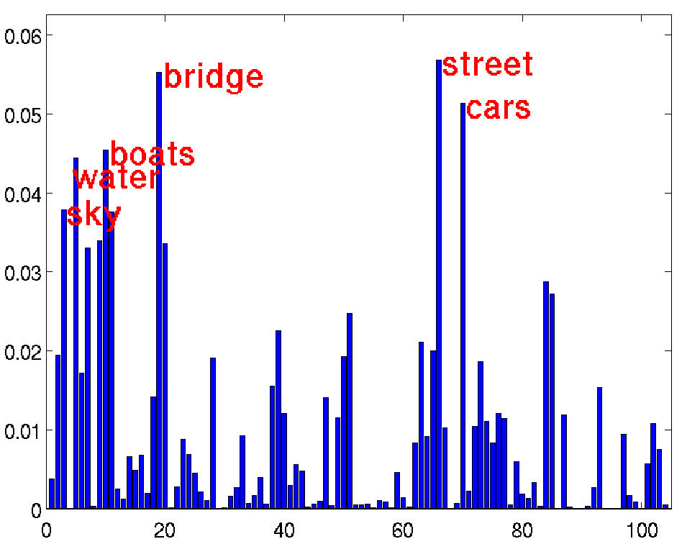
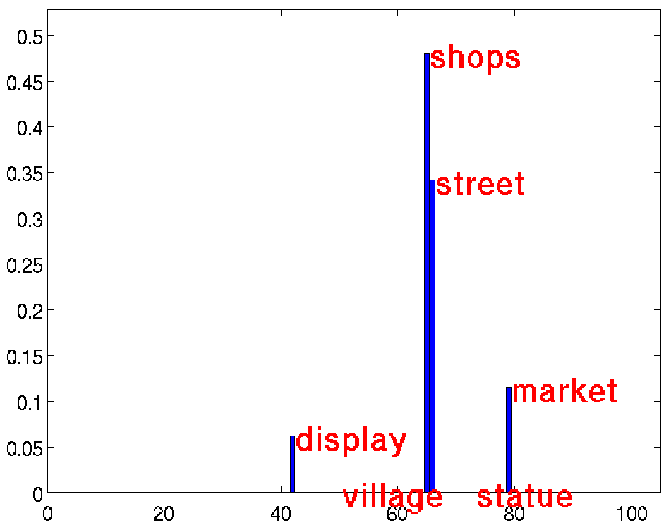
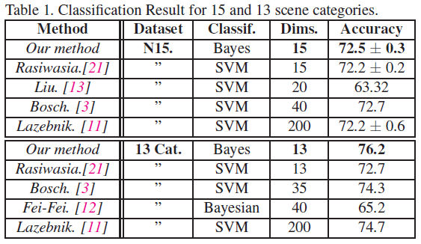
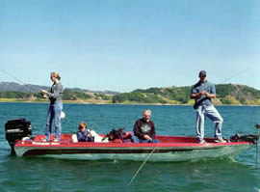
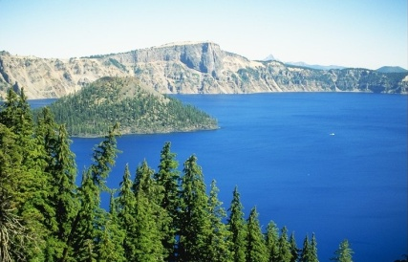
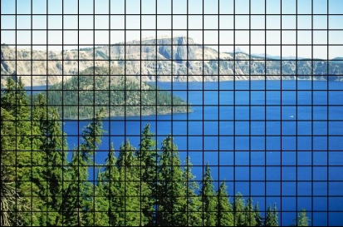
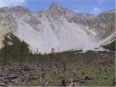
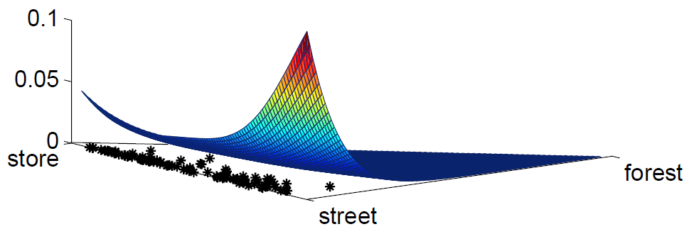



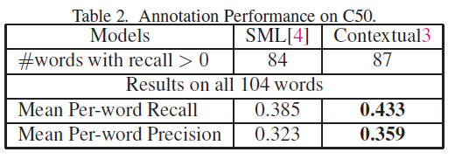




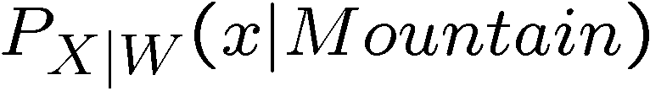
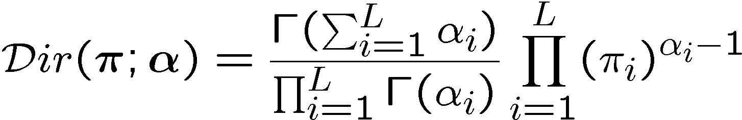

Holistic Context Modeling using Semantic Co-occurrences
Nikhil Rasiwasia, Dept. of Electrical and Computer Engineering, UCSD
Nuno Vasconcelos, Dept. of Electrical and Computer Engineering, UCSD
Contextual Cues
What is contextual noise?
Results
“ Detection of a concept of interest being facilitated by the presence of other concepts which may not themselves be of interest ”
Contextual
Co-occurrence
Ambiguity
Co-occurrence
Contextual Multinomial
Synonymy
Co-occurrence of different patches in an image from semantically related visual classes.
Polysemy
Co-occurrence of similar patches across images from semantically unrelated visual classes.
Appearance based models
Identify visual classes of interest
Design a set of appearance based features
Postulate an architecture for the classification of those features
Use statistical tools to learn optimal classifiers
Buildings
Thus in this image
Inside city, street, buildings.
Contextual Co-occurrence
Problem of Synonymy
Cars
An Image from ‘Street’ Class
Thus in this image
Livingroom, Bedroom, Kitchen
Ambiguity Co-occurrence
Problem of Polysemy
Does not explore contextual cues
Psychophysics studies have shown that humans use context for recognition [Biederman’82]
Fence
?
Semantic Multinomial
Contextual Multinomial
Context Based Models
Generating the contextual representation
Object Centric
Model contextual relationships between sub-image entities
  Co-occurrence of objects
  Spatial relationship between objects
  Relationship of an object with its surroundings
Appearance Based Class Models
Contextual Class Models
Training/Query Image
Scene Centric
Model context for the entire image
  No object based segmentation required
  Example: “gist” [Oliva’01] of the image
  Example: Represent image as bag of words and aggregate them across the entire image
Concept 1
. . .
. . .
x
Concept L
Proposed Approach
Contextual
Space
Scene Classification Performance
Combines both Object Centric and Scene Centric approaches.
Bag of features
Semantic
Multinomial
Concept 2
Dataset : 15 Natural Scene Categories [Lazebnik’05]
Learn appearance based models for concepts
Compute posterior probabilities or Semantic Multinomial (SMN) under appearance models.
  But, suffers from contextual noise
Model the distribution of SMN for each concept: assigns high probability to “contextual co-occurrences” and low probability to ambiguity co-occurrences.
Compute posterior probabilities under contextual models
Visual
concept models
Contextual
Multinomial
Contextual
Concept models
Semantic multinomial
Non Linear Mapping of the Image
vector of weights or
Learning the Visual Class Models [Carneiro’05]
Learning the Contextual Class Models
.2
.3
.2
.1
…
…
Lake
People
Sky
…
Boat
Water
Semantic Space
Bag of DCT vectors
+
+
+
Dirichlet Mixture Model
+
+
+
+
+
+
+
+
+
+
+
+
+
+
+
Concept 1
+
+
Gaussian Mixture Model
+
+
+
+
+
+
+
+
+
+
+
+
+
+
+
+
+
+
+
+
+
+
+
+
+
+
+
+
+
+
+
+
+
+
+
+
+
+
+
+
+
+
+
+
+
+
+
+
+
+
+
+
+
+
+
+
+
+
+
+
+
+
+
+
+
+
+
+
+
+
+
+
+
+
+
+
+
+
+
+
+
+
+
+
+
+
+
+
+
+
+
+
+
+
+
+
+
+
+
+
+
+
+
+
+
+
+
+
+
+
+
+
+
+
+
+
+
+
+
+
+
+
+
+
+
+
+
+
+
+
+
+
+
+
+
+
+
+
+
+
+
+
+
+
+
+
+
+
+
+
+
+
+
+
+
+
+
+
+
+
+
+
+
+
+
+
+
+
+
+
+
+
+
+
+
+
+
+
+
+
+
+
+
+
+
+
+
+
+
+
+
+
+
+
+
+
+
+
+
+
+
+
+
+
+
+
+
+
+
+
+
+
+
+
+
+
+
+
+
+
+
+
+
+
+
+
+
+
+
+
+
+
+
+
+
+
+
+
+
+
+
+
+
+
+
+
+
+
+
+
+
+
+
+
+
+
+
+
+
+
+
+
+
+
+
+
+
+
+
+
+
+
+
+
+
+
+
+
+
+
+
+
+
+
+
+
+
+
+
+
+
+
+
+
+
+
+
+
+
+
+
+
+
+
+
+
+
+
+
+
+
+
+
+
+
+
+
+
+
+
+
+
+
+
+
+
+
+
+
+
+
+
+
+
+
+
+
+
+
+
+
+
+
+
+
+
+
+
+
+
+
+
+
+
+
+
+
+
+
+
+
+
+
+
+
+
+
+
+
+
+
+
+
+
+
+
+
+
+
+
+
+
+
+
+
+
+
+
+
+
+
+
+
+
+
+
+
+
+
+
+
+
+
+
+
+
+
...
x
Image Annotation Performance
x
Concept L
w_{i} = mountain
mountain
Efficient Hierarchical Estimation
x
x
x
Dataset : Corel5k [Duygulu’02]
x
Visual Class Model
Concept
2
x
concept
training images
Semantic Space
Contextual model of the semantic concept.
Visual Features
Space
SVCL

