Slide 1
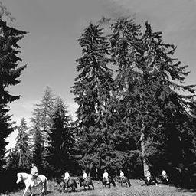
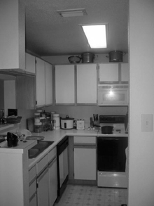
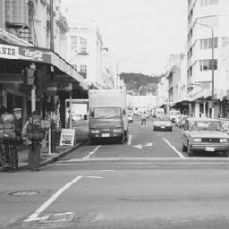
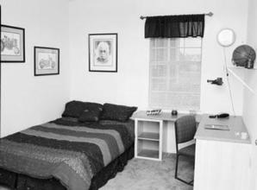
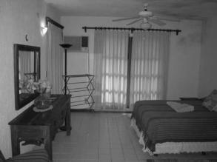
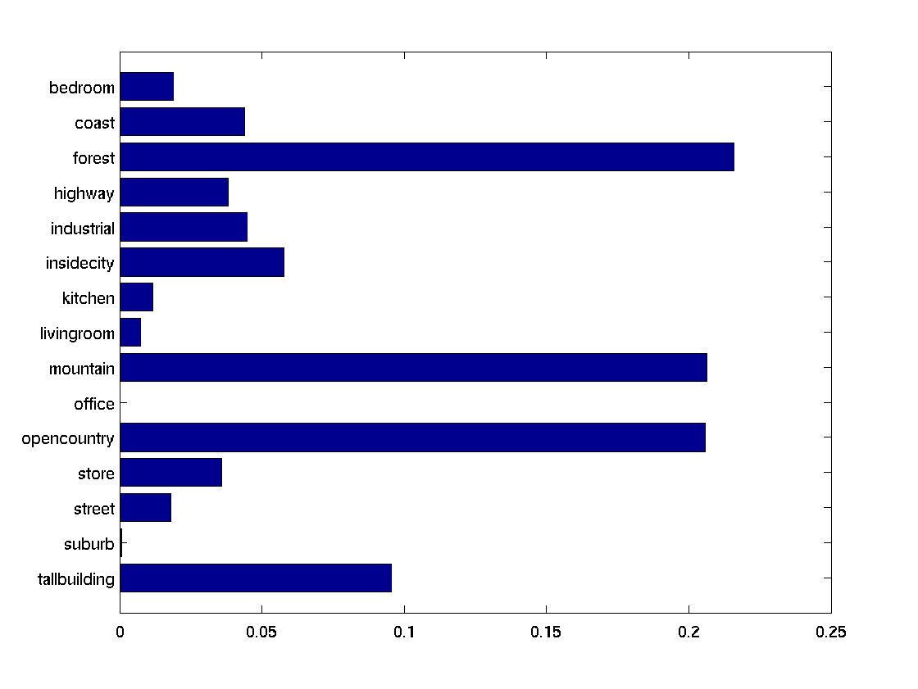
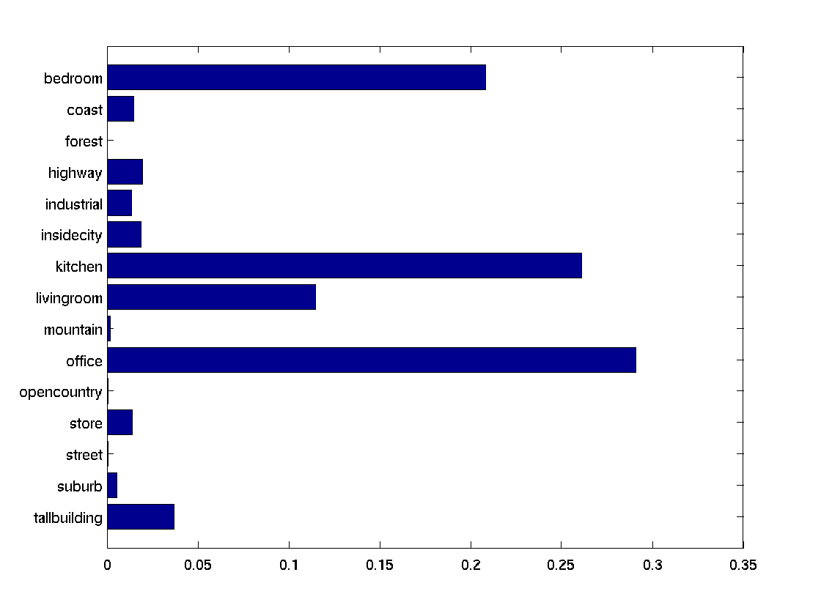
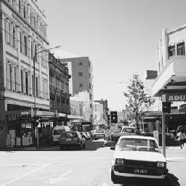
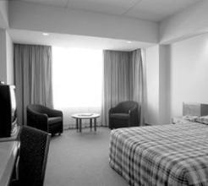
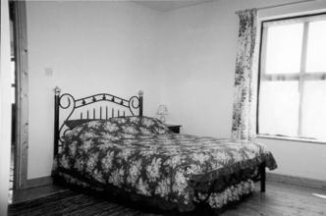
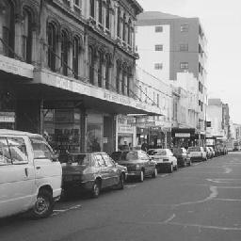
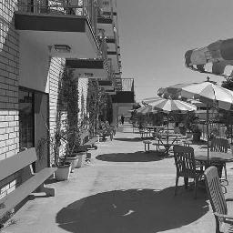
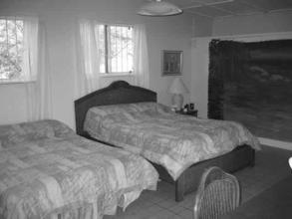
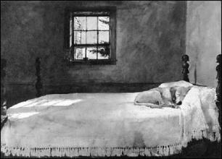
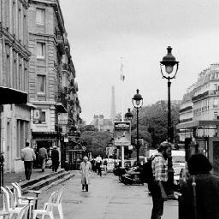
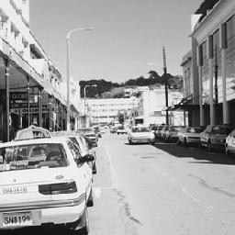
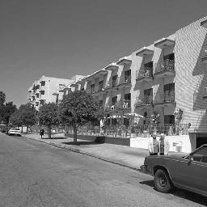
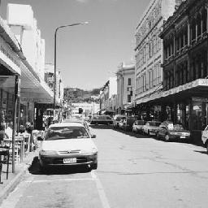
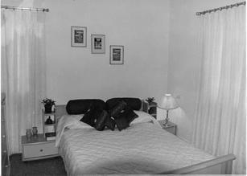
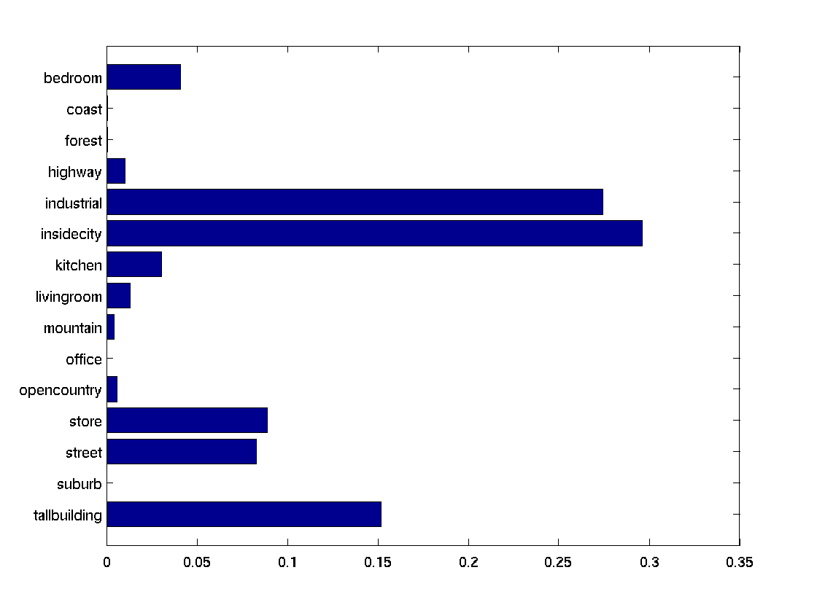
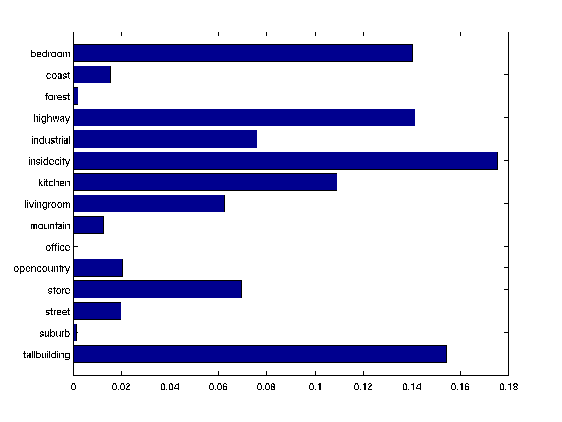
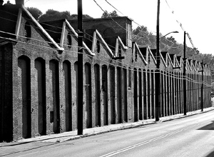
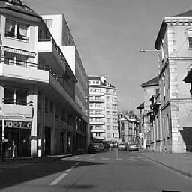
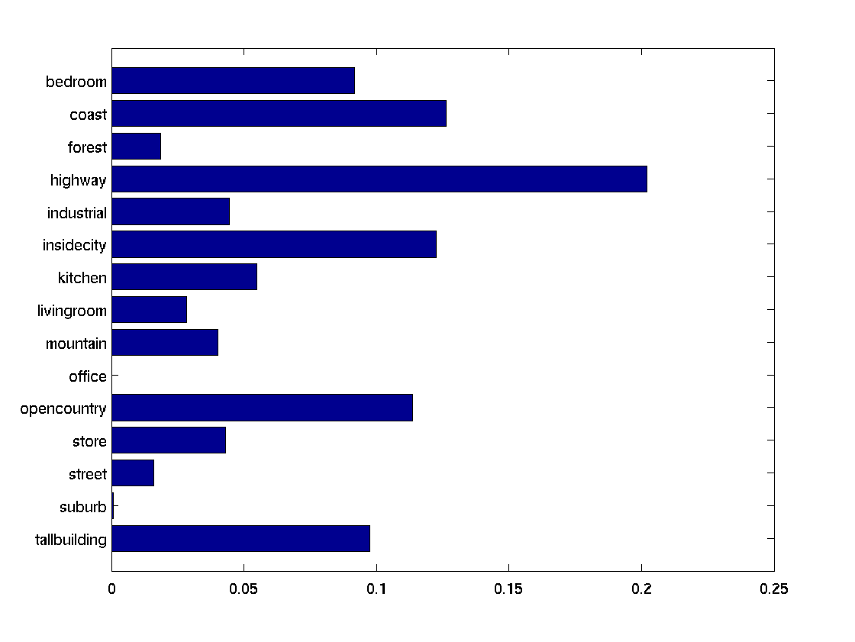
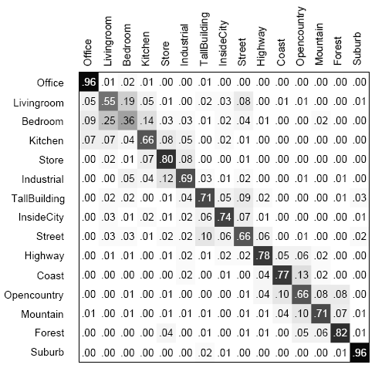
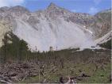
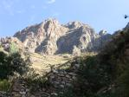
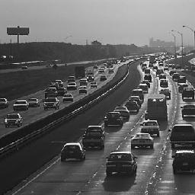
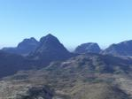
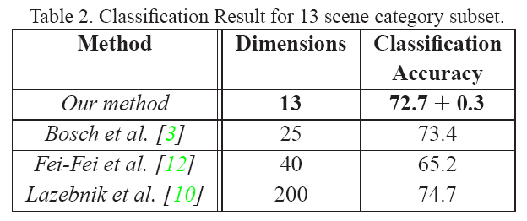
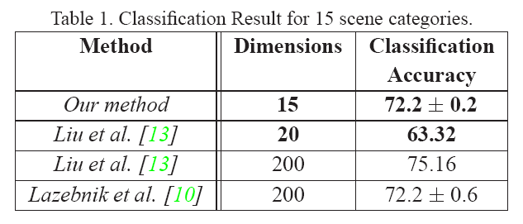
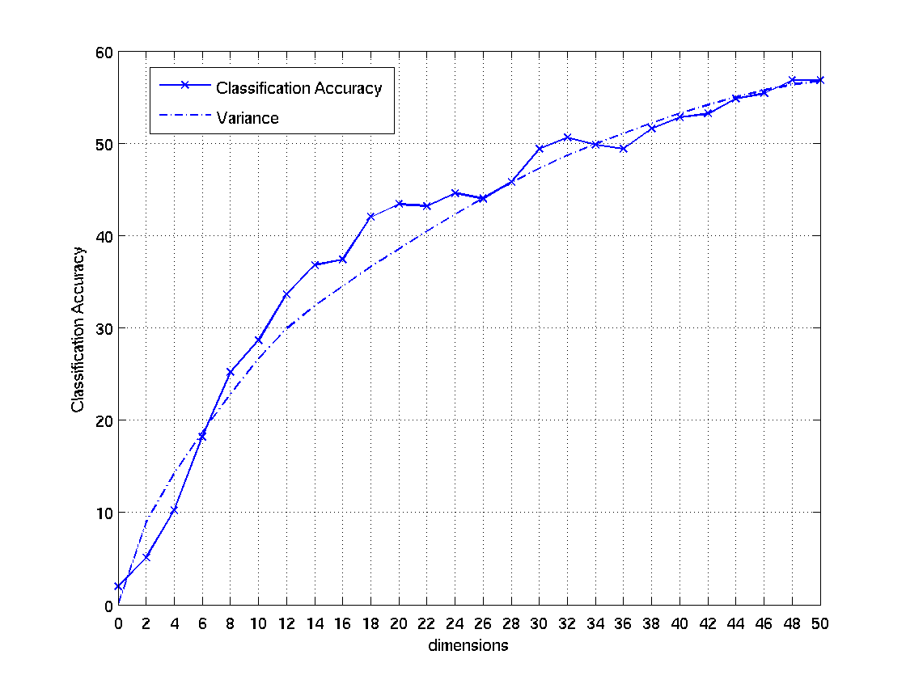
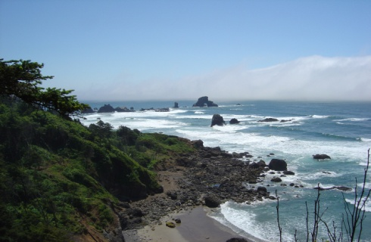
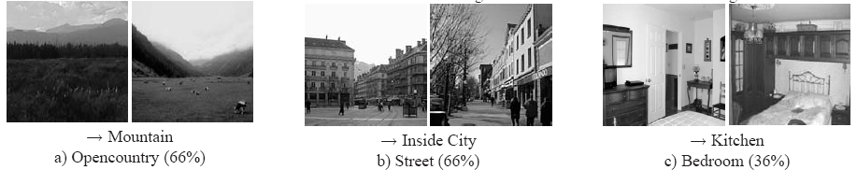
Scene Classification with Low-dimensional Semantic Spaces
Nikhil Rasiwasia, Dept. of Electrical and Computer Engineering, UCSD
Nuno Vasconcelos, Dept. of Electrical and Computer Engineering, UCSD
Scene Classification
System Architecture
Results
Classify a given image into one of the given scene class – eg, Bedroom, Forest, Open Country etc.
Theme 1
Correlates well with human understanding of
the image
Bedroom
Test Image
?
. . .
o
o
o
o
o
o
o
o
Theme L
x
x
x
x
x
x
x
Street
Theme models
Theme 2
x
x
x : images from Scene1
o : images from Scene2
Current Approaches
Image
Bag of features
Semantic Space
-- : SVM hyperplane
Captures co-occurrence patterns without
explicit training
[Fei-Fei’05, Quelhas’05, Lazebnik’05, Bosch’06, Liu’ 2007]
Theme vector
Represent images as Bag-of-features
No spatial information , yet performance is good.
Choose a feature space
DCT, SIFT, Gabor Filters etc
Build a “visual-word” vocabulary by clustering the features
Usually using Kmeans
Represent each cluster by its centroid or “visterms”
A collection of visterms is called a “codebook”
In general a codebook contains 100’s of visterms
Represent each image as a frequency vector over the codebook
Build a suitable classifier on top – Support Vector Machine
Learning Theme Models
Theme Vector
Bag of DCT vectors
Gaussian
Mixture
Model
Industrial
Street
+
+
+
+
+
+
+
+
+
+
+
+
+
+
+
+
+
+
+
+
+
+
+
+
+
+
+
+
+
+
+
+
+
+
+
+
+
+
+
+
+
+
+
+
+
+
+
+
+
+
+
+
+
+
+
+
+
+
+
+
+
+
+
+
+
+
+
+
+
+
+
+
+
+
+
+
+
+
+
+
+
+
+
+
+
+
+
+
+
+
+
+
+
+
+
+
+
+
+
+
+
+
+
+
+
+
+
+
+
+
+
+
+
+
+
+
+
+
+
+
+
+
+
+
+
+
+
+
+
+
+
+
+
+
+
+
+
+
+
+
+
+
+
+
+
+
+
+
+
+
+
+
+
+
+
+
+
+
+
+
+
+
+
+
+
+
+
+
+
+
+
+
+
+
+
+
+
+
+
+
+
+
+
+
+
+
+
+
+
+
+
+
+
+
+
+
+
+
+
+
+
+
+
+
+
+
+
+
+
+
+
+
+
+
+
+
+
+
+
+
+
+
+
+
+
+
+
+
+
+
+
+
+
+
+
+
+
+
+
+
+
+
+
+
+
+
+
+
+
+
+
+
+
+
+
+
+
+
+
+
+
+
+
+
+
+
+
+
+
+
+
+
+
+
+
+
+
+
+
+
+
+
+
+
+
+
+
+
+
+
+
+
+
+
+
+
+
+
+
+
+
+
+
+
+
+
+
+
+
+
+
+
+
+
+
+
+
+
+
+
+
+
+
+
+
+
+
+
+
+
+
+
+
+
+
+
+
+
+
+
+
+
+
+
+
+
+
+
+
+
+
+
+
+
+
+
+
+
+
+
+
+
+
+
+
+
+
+
+
+
+
+
+
+
+
+
+
+
+
+
+
+
+
+
+
+
+
+
+
+
+
+
+
+
+
+
+
+
+
SIFT( )
+
+
+
+
+
+
+
+
+
+
+
+
+
+
+
+
Space of SIFT features
+
+
+
+
+
+
+
+
+
+
+
+
+
+
+
+
theme_{i} = mountain
mountain
Efficient Hierarchical Estimation
Semantic Theme Model
Out-performs other latent-space approaches
“Formulating Semantics Image Annotation as a Supervised Learning Problem” [G. Carneiro’2007]
Detailed Approach
Experimental Setup
Bag of features representation of images.
Introduction of intermediate ‘theme’ space.
Themes are explicitly defined
Learned in a semi-supervised fashion.
If images are not labeled, use the scene labels
13 Scene Categories
Fei-Fei & Perona (2005), Oliva & Torralba (2001)
15 Scene category dataset
13 Scene category dataset + Lazebnik (2005)
50 Corel Stock Photo Cd’s
Duygulu(2002), Feng(2004), Caneiro (2005)
Classification
SVM using one-vs-all strategy with Gaussian Kernel
Parameters obtained by 3-fold cross validation
Experiments repeated for five times
Performance is measured by Classification Accuracy
Informative Semantic Dimensions.
Low-dimensional representations
Robustness to polysemy and synonymy
Remove redundancy, compact representation, faster computation.
Modeling co-occurrence patterns.
Scalability, both in terms of images and scene classes
Works in text retrieval. After-all, everything is inspired from text retrieval community
Varying dimensionality of theme vectors on Corel50
All the dimensions are not equally informative
Proportional to variance of semantic themes.
Image Representation
4 Themes
Theme: Gaussian Mixture Model with j components
Image: Multinomial density
Parameter estimates : MAP
“beach”
Codebook
Some examples of erroneous classification
*Image Courtesy Li. Fei Fei.
SVCL

